Slide 1

HOW TO MAKE TECHNICAL DECISIONS?

Slide 2
Examples
MongoDB
MySQL
Hibernate
JDBC
Maven
Gradle
implement
reuse

Slide 3

your WORST technical decision here

Slide 4
… let me help
own persistency layer
in PHP
2
non-compatible components
~ 300 dependencies each

Slide 5
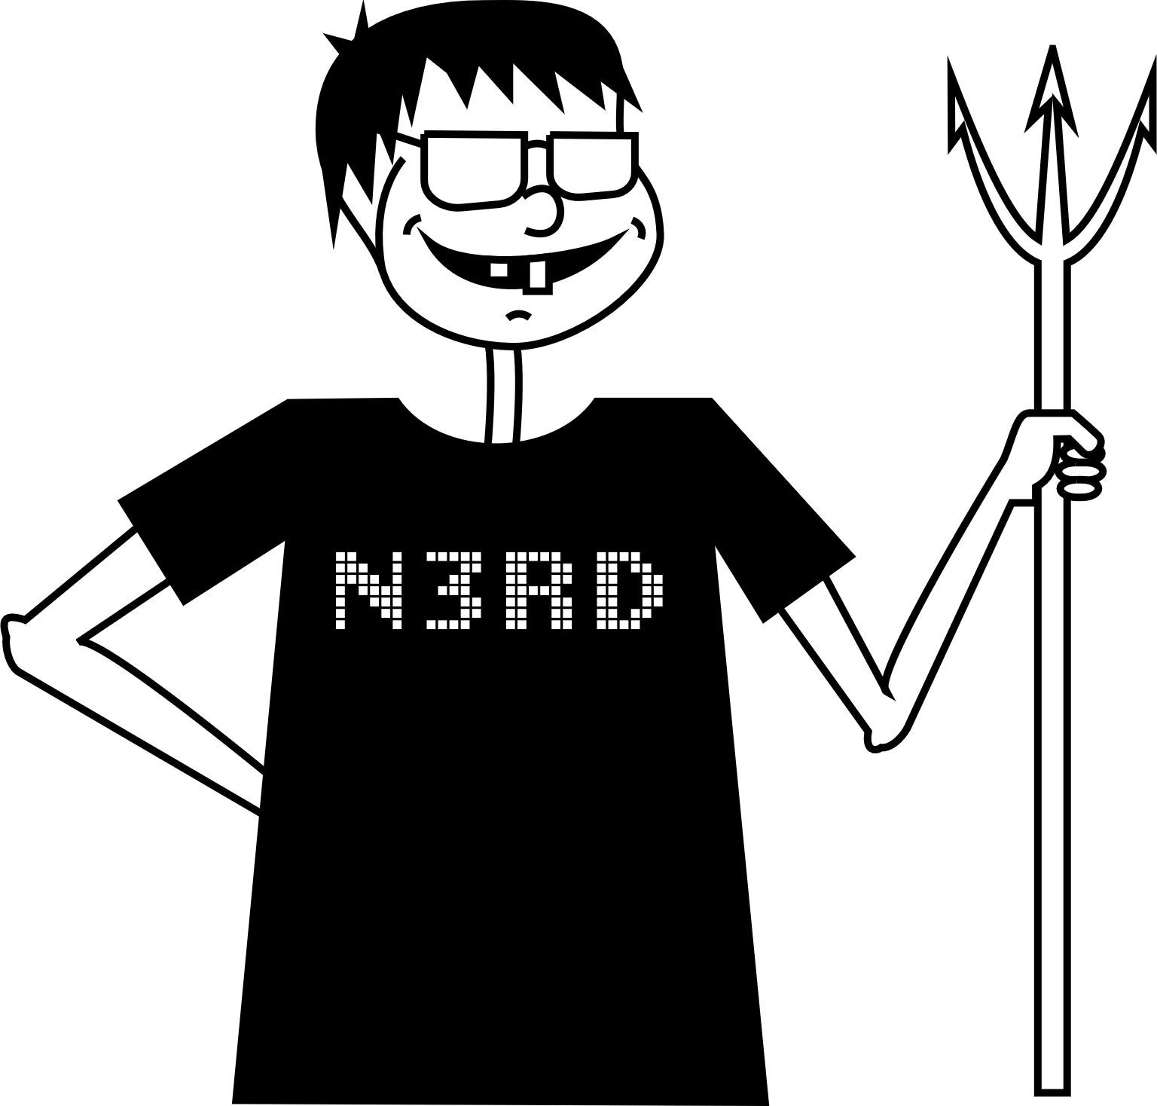
We all have war stories
implemented his own
framework & wants to
use it in the project

Slide 6
COST OF A BAD DECISION

Slide 7




STICKY
COGNITIVE NOISE
TECHNICAL DEBT
ACCIDENTAL COMPLEXITY
Notes:
(PAUSE)

Slide 8


Slide 9

SOLVES THE RIGHT PROBLEM

Slide 10
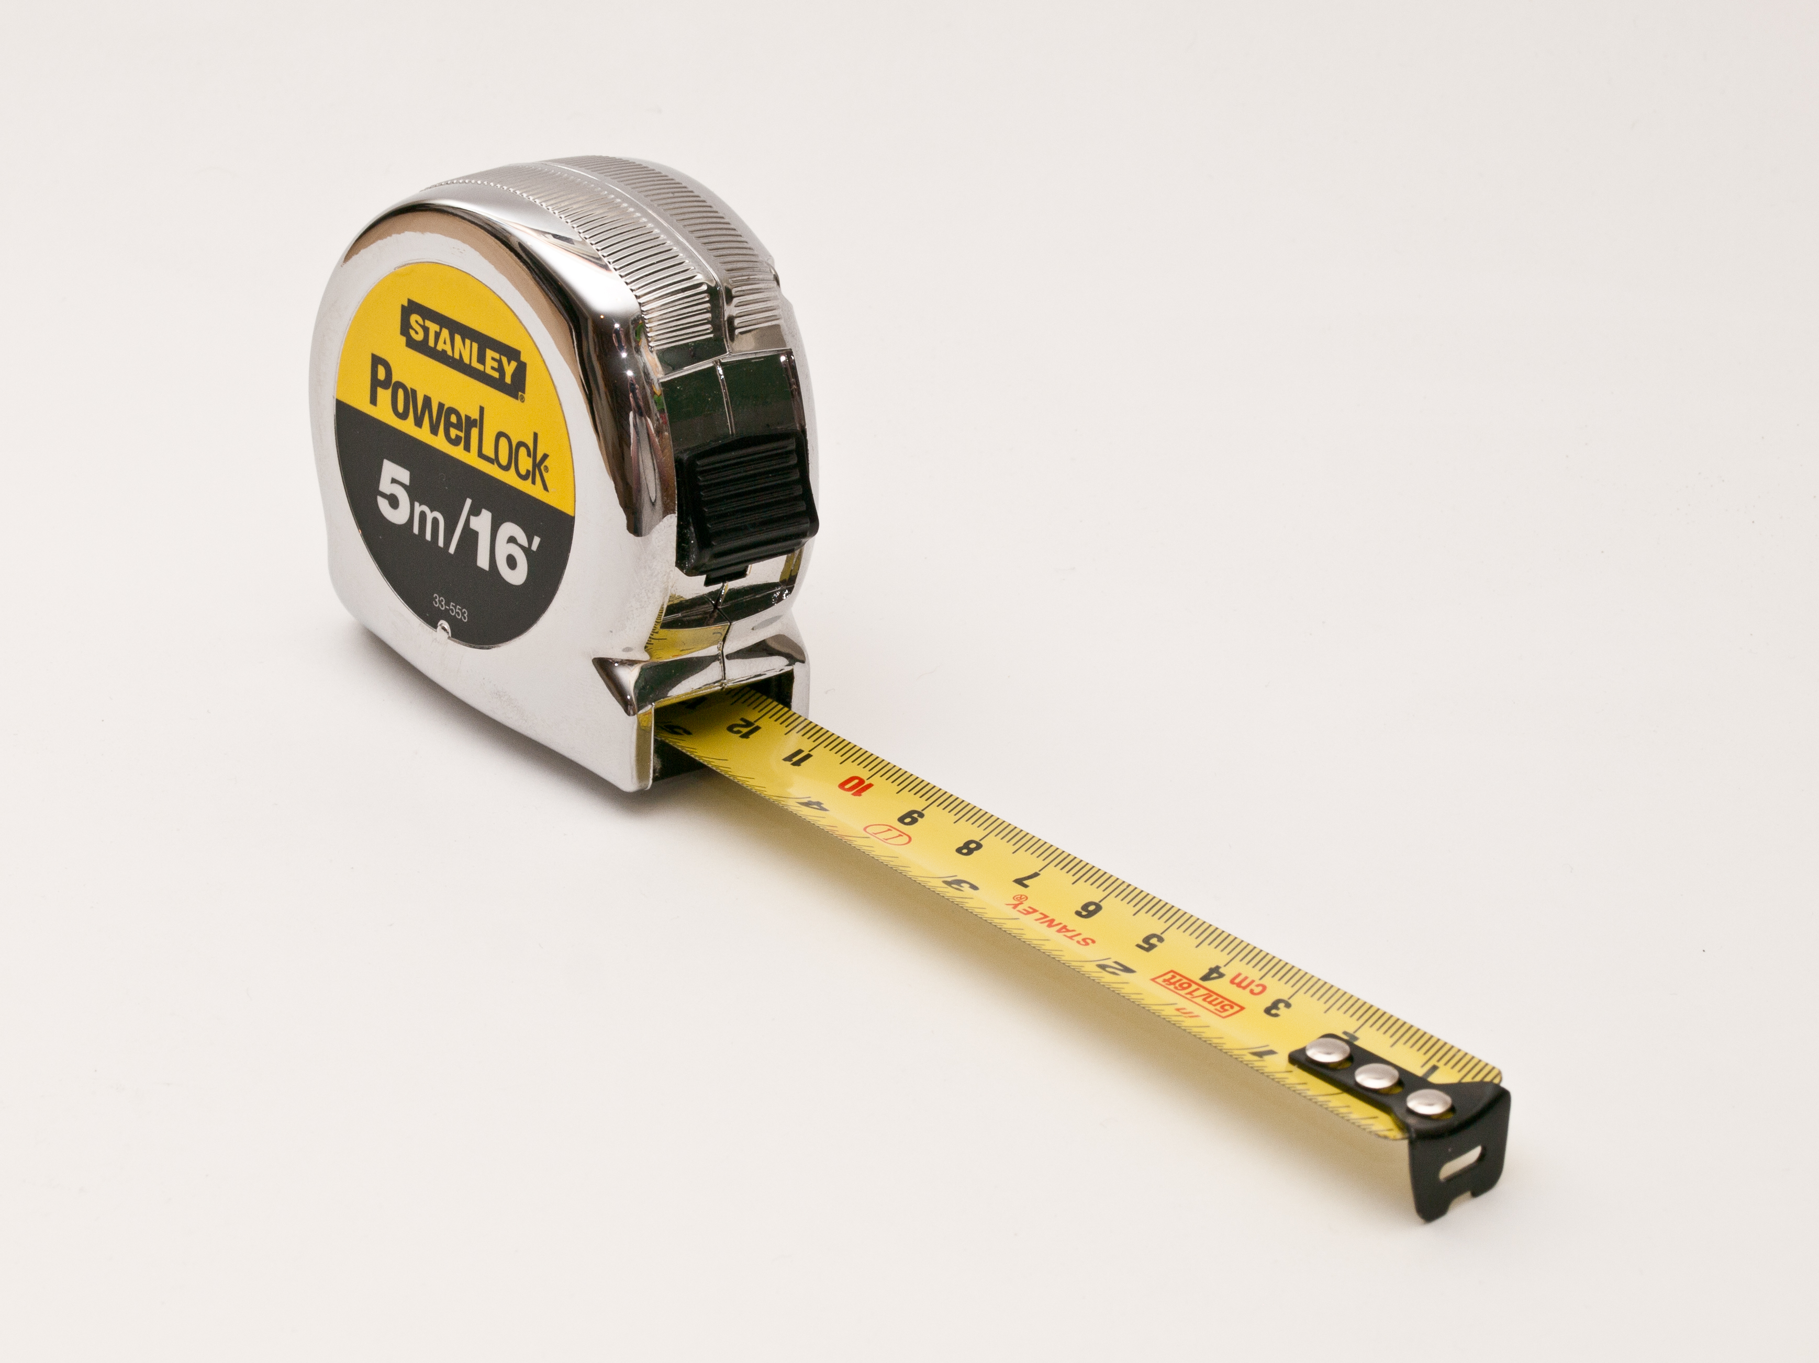
METRICS
Notes:
POLL!!!

Slide 11




EASY TO USE
MAINTAINABLE
FAST
NO SURPRISES

Slide 12
Learning
Curve
Design
Runtime

Slide 13
API
maturity
Design
simplicity
feature
richness
interfacing
(replaceable)

Slide 14
quality
docs
usability
Learning
Curve
fast feedback

Slide 15
feature richness
technical constraints
no SPOF
stability
performance
Runtime
debugging
logging
quality
of
feedback
monitoring
exceptions

Slide 16
API
maturity
quality
docs
usability
technical constraints
Design
simplicity
Learning
Curve
interfacing
(replaceable)
feature
richness
fast feedback
stability
debugging
Runtime
no SPOF
logging
quality
of
feedback
exceptions
performance
monitoring

